Slide 1
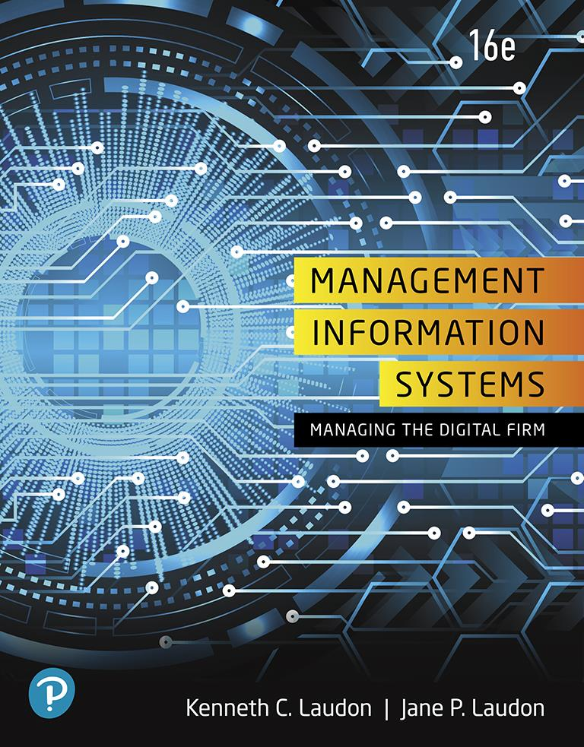
Management Information Systems: Managing the Digital Firm
Sixteenth Edition
Chapter 4
Ethical and Social Issues in Information Systems
Copyright © 2020, 2018, 2016 Pearson Education, Inc. All Rights Reserved
Notes:
If this PowerPoint presentation contains mathematical equations, you may need to check that your computer has the following installed:
1) MathType Plugin
2) Math Player (free versions available)
3) NVDA Reader (free versions available)

Slide 2
Learning Objectives
4.1 What ethical, social, and political issues are raised by information systems?
4.2 What specific principles for conduct can be used to guide ethical decisions?
4.3 Why do contemporary information systems technology and the Internet pose challenges to the protection of individual privacy and intellectual property?
4.4 How have information systems affected laws for establishing accountability, liability, and the quality of everyday life?
4.5 How will M I S help my career?
Notes:
This chapter examines the ethical, social, and political issues raised by information systems. It can be useful to ask students to help you put together a list of these issues categorized into ethical, social, and political columns.

Slide 3
Video Cases
Case 1: What Net Neutrality Means for You
Case 2: Facebook and Google Privacy: What Privacy?
Case 3: United States v. Terrorism: Data Mining for Terrorists and Innocents
Instructional Video: Viktor Mayer-Schönberger on the Right to Be Forgotten

Slide 4
Are Cars Becoming Big Brother on Wheels? (1 of 2)
Problem
Opportunities from new technology
Undeveloped legal environment
Solutions
Develop big data strategy
Develop privacy policies
Collect car-generated data
Analyze car/driver data
Smartphones, event data recorders
In-car diagnostics/navigation/entertainment

Slide 5
Are Cars Becoming Big Brother on Wheels? (2 of 2)
Vehicle and driver monitoring systems
Demonstrates how technological innovations can be a double-edged sword
Illustrates how I T systems create consumer benefits and costs

Slide 6
What Ethical, Social, and Political Issues are Raised by Information Systems? (1 of 2)
Recent cases of failed ethical judgment in business
Wells Fargo, Deerfield Management, General Motors, Takata Corporation
In many, information systems used to bury decisions from public scrutiny
Ethics
Principles of right and wrong that individuals, acting as free moral agents, use to make choices to guide their behaviors
Notes:
Almost every day there examples of business ethical failures reported in the news media. Ask the class to come up with current examples of ethical lapses in well-known organizations and firms. Put the list on the blackboard or screen. What role do they think information systems played in these ethical failures? Either a positive role by helping to expose ethical lapses, or a negative role by enabling these events.

Slide 7
What Ethical, Social, and Political Issues are Raised by Information Systems? (2 of 2)
Information systems raise new ethical questions because they create opportunities for:
Intense social change, threatening existing distributions of power, money, rights, and obligations
New opportunities for crime
New kinds of crimes
Notes:
Ask students to describe some of the ethical dilemmas that are presented by information systems and new developments in technology. Privacy is an important issue—mention the opening case again and explain that the business models of Google, Facebook, and many other sites depend on getting users to give up their personal information so it can be used to market and sell them products.

Slide 8
A Model for Thinking About Ethical, Social, and Political Issues
Society as a calm pond
I T as rock dropped in pond, creating ripples of new situations not covered by old rules
Social and political institutions cannot respond overnight to these ripples—it may take years to develop etiquette, expectations, laws
Requires understanding of ethics to make choices in legally gray areas
Notes:
Can students provide any examples of how IT has challenged some area of ethics, social life, or legal arrangements? Cell phones, computer games, surveillance cameras come to mind.

Slide 9
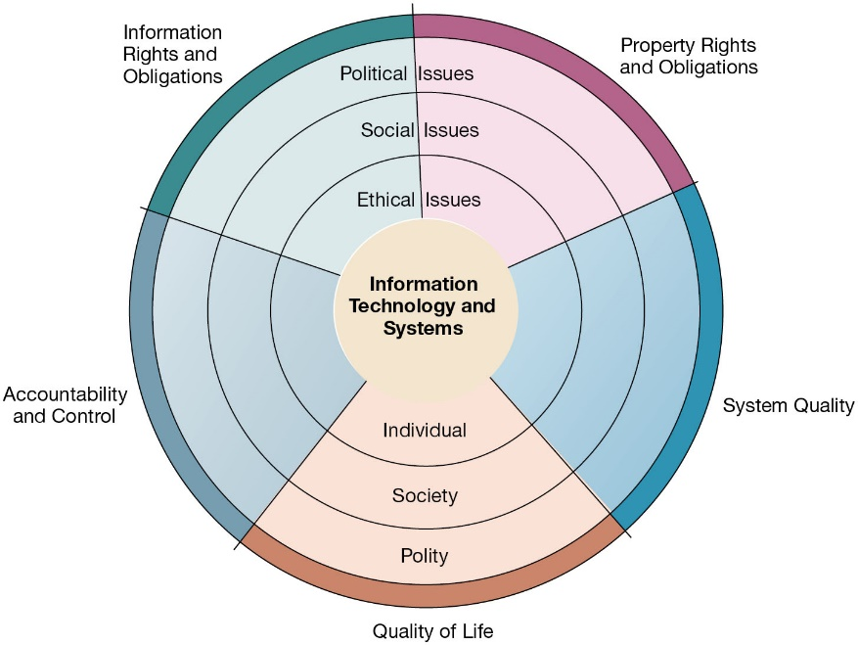
Figure 4.1 The Relationship Between Ethical, Social, and Political Issues in an Information Society
Notes:
Figure 4.1, Page 125.
The introduction of new information technology has a ripple effect, raising new ethical, social, and political issues that must be dealt with on the individual, social, and political levels. These issues have five moral dimensions: information rights and obligations, property rights and obligations, system quality, quality of life, and accountability and control.
Explain to students that the graphic displays the five moral dimensions listed in the caption. Consider online P2P bit torrent shared music and films as an example of how a new technology has ethical, social, and eventually political (legal) ramifications. If music can be stolen, why pay any money for it? Why should anyone care about record labels or artist’s income?
Full description: A diagram shows the relationship between ethical, social, and political issues in an information society. The diagram shows five concentric circles with the innermost circle labeled as Information Technology and Systems. The next three circles are labeled as follows. Ethical issues Individual, Social issues Society, Political issues Polity. Each of these circles is divided into five segments representing following five moral dimensions. Information Rights and Obligations, Property Rights and Obligations, System Quality, Quality of Life, and Accountability and Control.

Slide 10
Five Moral Dimensions of the Information Age
Information rights and obligations
Property rights and obligations
Accountability and control
System quality
Quality of life
Notes:
Give examples of each of the five major issues. For example, an issue dealing with information rights might be: what rights do individuals possess with respect to themselves? What do they have a right to protect? An issue dealing with quality of life might be: what values should be preserved in an information- and knowledge-based society? An issue dealing with system quality might be: what standards of data and system quality should we demand to protect individual rights and the safety of society?

Slide 11
Key Technology Trends That Raise Ethical Issues
Computing power doubles every 18 months
Data storage costs rapidly decline
Data analysis advances
Networking advances
Mobile device growth impact
Notes:
Which of these trends do students believe might have the most adverse consequences? Why do they feel this way? Do the positives outweigh the negatives for all four issues? Why or why not?

Slide 12
Advances in Data Analysis Techniques
Profiling
Combining data from multiple sources to create dossiers of detailed information on individuals
Nonobvious relationship awareness (N O R A)
Combining data from multiple sources to find obscure hidden connections that might help identify criminals or terrorists
Notes:
Online profiling is one of the most controversial computer-related ethical, social, and political issues today. Although it is used fairly extensively on the Internet, it is also used by insurance firms, health insurance firms, casinos, and of course national authorities around the globe for finding potential terrorists, as well as domestic opponents.

Slide 13
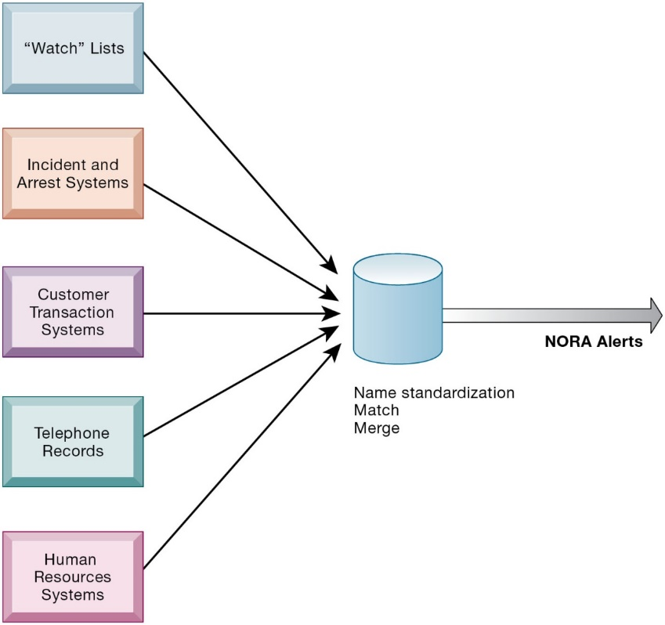
Figure 4.2 Nonobvious Relationship Awareness (N O R A)
Notes:
Figure 4.2, Page 128.
NORA technology can take information about people from disparate sources and find obscure, nonobvious relationships. It might discover, for example, that an applicant for a job at a casino shares a telephone number with a known criminal and issue an alert to the hiring manager.
Explain that NORA is used by both the government and the private sector for its profiling capabilities. Ask students to provide potential examples of NORA (other than the one mentioned in the caption) for both governmental and business purposes. One such example might be an airline identifying potential terrorists attempting to board a plane. Another might be government identifying potential terrorists by monitoring phone calls.
Full description: A diagram shows the components of nonobvious relationship awareness. The components shown are as follows. Watch Lists, Incident and Arrest Systems, Customer Transaction Systems, Telephone Records, and Human Resources Systems. All these components together lead to the following categories. Name standardization, Match, and Merge. An arrow from these categories is labeled as N O R A Alerts.

Slide 14
Basic Concepts: Responsibility, Accountability, and Liability
Responsibility
Accepting the potential costs, duties, and obligations for decisions
Accountability
Mechanisms for identifying responsible parties
Liability
Permits individuals (and firms) to recover damages done to them
Due process
Laws are well-known and understood, with an ability to appeal to higher authorities
Notes:
Explain that information systems do not exist in a vacuum and that these concepts are instrumental in understanding the impact of systems and measuring their success. Ask students why liability and due process are such important ethical concepts? (A rough answer would be that they provide recourse to individuals negatively effected by mismanagement of information systems, providing incentive to “play by the rules”.)

Slide 15
Ethical Analysis
Five-step process for ethical analysis
Identify and clearly describe the facts.
Define the conflict or dilemma and identify the higher-order values involved.
Identify the stakeholders.
Identify the options that you can reasonably take.
Identify the potential consequences of your options.
Notes:
Do students believe that any aspect of ethical analysis is lacking from this process? If so, what? Can students offer a brief example of an ethical dilemma and how they would resolve it using this process? One class exercise is to work with students to identify an ethical situation they are aware of, or that may have been in the news. Then, go through the ethical analysis described in the slide to illustrate the process of analyzing an ethical situation.

Slide 16
Candidate Ethical Principles (1 of 2)
Golden Rule
Do unto others as you would have them do unto you
Immanuel Kant’s Categorical Imperative
If an action is not right for everyone to take, it is not right for anyone
Slippery Slope Rule
If an action cannot be taken repeatedly, it is not right to take at all
Notes:
Ensure that students understand the difference between the categorical imperative and the rule of change. Briefly, the difference is that the categorical imperative spans the entirety of the populace, whereas the rule of change applies to the decisions of one person over time. For example, the categorical imperative applies to an employee who tries to steal money from his employer. He shouldn’t do this, because if all employees attempted to do so, the company would fail. The rule of change applied to the same situation might run as follows: although the employee’s stealing one dollar from the company would not lead to any true problem, repeatedly stealing one dollar, or stealing a lot of dollars, would be unacceptable and ultimately lead to the destruction of the company.

Slide 17
Candidate Ethical Principles (2 of 2)
Utilitarian Principle
Take the action that achieves the higher or greater value
Risk Aversion Principle
Take the action that produces the least harm or potential cost
Ethical “No Free Lunch” Rule
Assume that virtually all tangible and intangible objects are owned by someone unless there is a specific declaration otherwise
Notes:
How does the “no free lunch” rule relate to copyrights, patents, and trademarks? (These concepts are discussed in later slides.)
Explain that the appearance of unethical behavior is as harmful as actual unethical behavior at times, so adherence to these principles are critical. In an age of “open source software” how does the principle of “no free lunch” work out? Open source software is an example of an economic good which is licensed by the creator for distribution often without charge, or even attribution. In this case, there is a “free lunch.” But it occurs because the creators of the software consent to this arrangement.

Slide 18
Professional Codes of Conduct
Promulgated by associations of professionals
American Medical Association (A M A)
American Bar Association (A B A)
Association for Computing Machinery (A C M)
Promises by professions to regulate themselves in the general interest of society

Slide 19
Real-World Ethical Dilemmas
One set of interests pitted against another
Examples
Monitoring employees: Right of company to maximize productivity of workers versus workers’ desire to use Internet for short personal tasks
Facebook monitors users and sells information to advertisers and app developers
Notes:
Other ethical dilemmas include companies trying to use new systems to reduce the size of their workforce, such as using automated systems to reduce the need for human call center employees. Emphasize that in cases like these, right and wrong are not clearly defined, but instead, contrasting values are at odds with one another (companies value productivity, employees value their work and pay).

Slide 20
Information Rights: Privacy and Freedom in the Internet Age (1 of 3)
Privacy
Claim of individuals to be left alone, free from surveillance or interference from other individuals, organizations, or state; claim to be able to control information about yourself
In the United States, privacy protected by:
First Amendment (freedom of speech and association)
Fourth Amendment (unreasonable search and seizure)
Additional federal statues (e.g., Privacy Act of 1974)
Notes:
Do students believe that there are sufficient protections for privacy in law? If not, what are possible methods of developing appropriate privacy protections? Table 4.3 in the text lists a variety of other laws affecting both the government and private institutions, but few areas of the private sector are as well regulated with respect to privacy. Do an in-class poll and ask students who among them feel they can control the use of their personal information on the Internet. You should get no one raising their hand.

Slide 21
Information Rights: Privacy and Freedom in the Internet Age (2 of 3)
Fair information practices
Set of principles governing the collection and use of information
Basis of most U.S. and European privacy laws
Used to drive changes in privacy legislation
C O P P A
Gramm-Leach-Bliley Act
H I P A A
Notes:
Explain what is meant by a “mutuality of interest between record holder and individual.” (Briefly, the individual wants to engage in a transaction, and the record holder needs information about the individual to support the transaction—both are interested parties in the transaction.)

Slide 22
Information Rights: Privacy and Freedom in the Internet Age (3 of 3)
F T C F I P principles
Notice/awareness (core principle)
Choice/consent (core principle)
Access/participation
Security
Enforcement
Notes:
Do students believe that the websites they visit actually disclose their data collection and utilization practices? Is it difficult to find where?

Slide 23
EU General Data Protection Regulation (G D P R)
Requires unambiguous explicit informed consent of customer
E U member nations cannot transfer personal data to countries without similar privacy protection
Applies across all E U countries to any firms operating in E U or processing data on E U citizens or residents
Strengthens right to be forgotten
Privacy Shield: All countries processing E U data must conform to G D P R requirements
Heavy fines: 4% of global daily revenue
Notes:
EU protections of privacy are far more powerful than the United States because they require informed consent before a firm can do anything with personal information besides support the transaction at hand. In Europe, there is no junk postal mail for instance because advertising firms are prohibited from using personal information obtained from third parties, and without the consent of the individual.

Slide 24
Internet Challenges to Privacy (1 of 2)
Cookies
Identify browser and track visits to site
Super cookies (Flash cookies)
Web beacons (web bugs)
Tiny graphics embedded in e-mails and web pages
Monitor who is reading email message or visiting site
Spyware
Surreptitiously installed on user’s computer
May transmit user’s keystrokes or display unwanted ads
Google services and behavioral targeting
Notes:
What are students’ attitudes toward these technologies? Emphasize that cookies can be useful at trusted sites, but perhaps invasive at others. Have students had any experience with spyware or web bugs on their own computers? How would they know they are being tracked?

Slide 25
Internet Challenges to Privacy (2 of 2)
The United States allows businesses to gather transaction information and use this for other marketing purposes.
Opt-out v s. opt-in model
Online industry promotes self-regulation over privacy legislation.
Complex/ambiguous privacy statements
Opt-out models selected over opt-in
Online “seals” of privacy principles
Notes:
Do students believe that businesses should be pressed to provide more comprehensive privacy protections online? Explain that businesses prefer the looser regulation, but that individuals may not. Also emphasize that most individuals do not take the proper steps to ensure their own privacy in any case. Most people do not know how to protect their privacy online. Does that mean that privacy is unimportant to them, or that people don’t care their privacy?

Slide 26
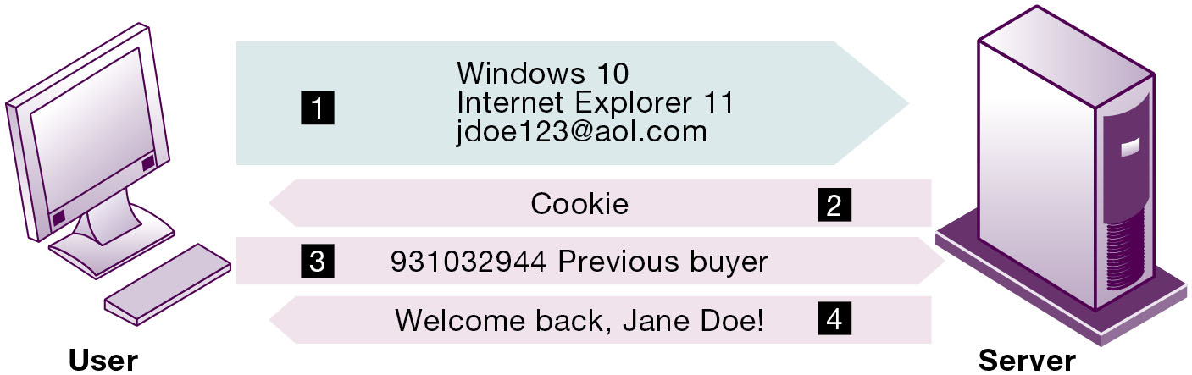
Figure 4.3 How Cookies Identify Web Visitors
The Web server reads the user's Web browser and determines the operating system, browser name, version number, Internet address, and other information.
The server transmits a tiny text file with user identification information called a cookie, which the user's browser receives and stores on the user's computer.
When the user returns to the Web site, the server requests the contents of any cookie it deposited previously in the user's computer.
The Web server reads the cookie, identifies the visitor, and calls up data on the user.
Notes:
Figure 4.3, Page 136.
Cookies are written by a website on a visitor’s hard drive. When the visitor returns to that website, the web server requests the ID number from the cookie and uses it to access the data stored by that server on that visitor. The website can then use these data to display personalized information.
Ask students to pinpoint where potential privacy invasions might occur in the process shown above. Students may suggest that no real privacy violation is occurring in the figure, which is a legitimate point of view. If so, ask them how they might feel about a website they did not trust engaging in the displayed process.
Full description: A diagram shows four steps involved in identifying web visitors by cookies. The diagram shows User at one end and Server at the other end with four steps shown between them as follows. 1. Windows 10, Internet Explorer 11, and j doe 1 2 3 at a o l dot com. 2. Cookie. 3. 9 3 1 0 3 2 9 4 4 Previous buyer. 4. Welcome back, Jane Doe.

Slide 27
Technical Solutions
Solutions include:
Email encryption
Anonymity tools
Anti-spyware tools
Overall, technical solutions have failed to protect users from being tracked from one site to another
Browser features
“Private” browsing
“Do not track” options
Notes:
How many students have used technical solutions to protect their privacy? How many have used a browser like Epic that prevents all tracking software from being loaded on a computer?

Slide 28
Property Rights: Intellectual Property
Intellectual property
Tangible and intangible products of the mind created by individuals or corporations
Protected in four main ways:
Copyright
Patents
Trademarks
Trade secret
Notes:
Do students believe that the property rights guaranteed by copyrights, patents, trademarks, and trade secrets are strong enough to avoid the theft of intellectual property online? Give an example of a copyright (which could include the copyright of a photo or newspaper article). Give an example of a patent (such as Amazon's One-Click shopping as a business process patent, or Kodak‘s claim to have a patent on digital still cameras with digital displays for a viewfinder). Give an example of a trademark (such as the Google icon). And give an example of a trade secret (the formula for Coke; a method of doing business or business process).

Slide 29
Challenges to Intellectual Property Rights
Digital media different from physical media
Ease of replication
Ease of transmission (networks, Internet)
Ease of alteration
Compactness
Difficulties in establishing uniqueness
Digital Millennium Copyright Act (D M C A)
Notes:
Students may be unwilling to admit to infringing upon intellectual property rights themselves, but ask them whether they are familiar with the Internet and its ability to bypass intellectual property protections. Do they believe that legislation such as the DMCA is having any effect? How many have friends who download “free” music from P2P sights? Free videos?

Slide 30
Computer-Related Liability Problems
If software fails, who is responsible?
If seen as part of a machine that injures or harms, software producer and operator may be liable
If seen as similar to book, difficult to hold author/publisher responsible
If seen as a service, would this be similar to telephone systems not being liable for transmitted messages?
Notes:
Using the example from the text, who do students consider to be the liable party for the incident involving Target’s data breach? Is Target responsible for allowing the breach to occur despite efforts it made to secure the information? Should the breach be considered just a cost of doing business in the current age, where businesses have insurance policies to protect them against losses and customers have a maximum liability of $50 for fraudulent credit card purchases?

Slide 31
System Quality: Data Quality and System Errors
What is an acceptable, technologically feasible level of system quality?
Flawless software is economically unfeasible
Three principal sources of poor system performance
Software bugs, errors
Hardware or facility failures
Poor input data quality (most common source of business system failure)
Notes:
Do students have any opinion about when software is “good enough?” Does it depend on the particular product? For example, distinguish between software used by air traffic controllers and software used for word processing. Do students believe that there are different levels of acceptable quality for these products?

Slide 32
Quality of Life: Equity, Access, Boundaries (1 of 3)
Negative social consequences of systems
Balancing power: center versus periphery
Rapidity of change: reduced response time to competition
Maintaining boundaries: family, work, and leisure
Dependence and vulnerability
Computer crime and abuse
Notes:
Ask students whether they have witnessed any of these negative consequences first hand. It's likely that they know someone who has become dependent on their computer to some extent or have even experienced something similar first hand. Which of the above consequences do students feel is the most alarming?

Slide 33
Quality of Life: Equity, Access, Boundaries (2 of 3)
Computer crime and abuse
Computer crime
Computer abuse
Spam
CAN-SPAM Act of 2003
Employment
Trickle-down technology
Reengineering job loss
Notes:
Ask students what experience they have had with spam. A notable statistic is that spam accounts for around 60% of all email traffic and is relatively unlikely to decrease, because it is so difficult to regulate and so cheap to send.
Do students believe that the end result of continuing advances in information technology will be rising unemployment and a small number of elite corporate professionals? Students may enjoy debating this idea, which is somewhat far-fetched, but conceptually stimulating. There is some evidence that today’s manufacturing technology (including robots and computer controlled machines) is displacing factory jobs.

Slide 34
Quality of Life: Equity, Access, Boundaries (3 of 3)
Equity and access
The digital divide
Health risks
Repetitive stress injury (R S I)
Carpal tunnel syndrome (C T S)
Computer vision syndrome (C V S)
Technostress
Notes:
Have students encountered any of these health risks, either from personal experience or from someone they know?

Slide 35
Interactive Session: Organizations: Will Automation Kill Jobs?
Class discussion
Identify the problem described in this case study. In what sense is it an ethical dilemma?
Should more tasks be automated? Why or why not? Explain your answer.
Can the problem of automation reducing cognitive skills be solved? Explain your answer.

Slide 36
Interactive Session: Technology: How Harmful Are Smartphones?
Class discussion
Identify the problem described in this case study. In what sense is it an ethical dilemma?
Should restrictions be placed on children’s and teenagers’ smartphone use? Why or why not?
Can the problem of smartphones reducing cognitive skills be solved? Why or why not? Explain your answer.
Have children? What's your policy?

Slide 37
How Will M I S Help My Career?
The Organization: Pinnacle Air Force Base
Position Description: Junior privacy analyst
Job Requirements
Interview Questions
Author Tips
Notes:
A good opportunity for a class discussion of the new Section on careers. Would any in the class be interested in a job like this? What do they think are the most important skills the employer is looking for? How would they answer the interviewer questions?

Slide 38

Copyright
This work is protected by United States copyright laws and is provided solely for the use of instructors in teaching their courses and assessing student learning. Dissemination or sale of any part of this work (including on the World Wide Web) will destroy the integrity of the work and is not permitted. The work and materials from it should never be made available to students except by instructors using the accompanying text in their classes. All recipients of this work are expected to abide by these restrictions and to honor the intended pedagogical purposes and the needs of other instructors who rely on these materials.

